Slide 1
Microsoft Power Automate Example using Stock Prices
Sungsoo Kang

Slide 2
Purpose
Using Microsoft Power Automate to create an automated work flow to
1. Look up current stock prices and
2. Record 52 week ranges
of several stocks I follow

Slide 3
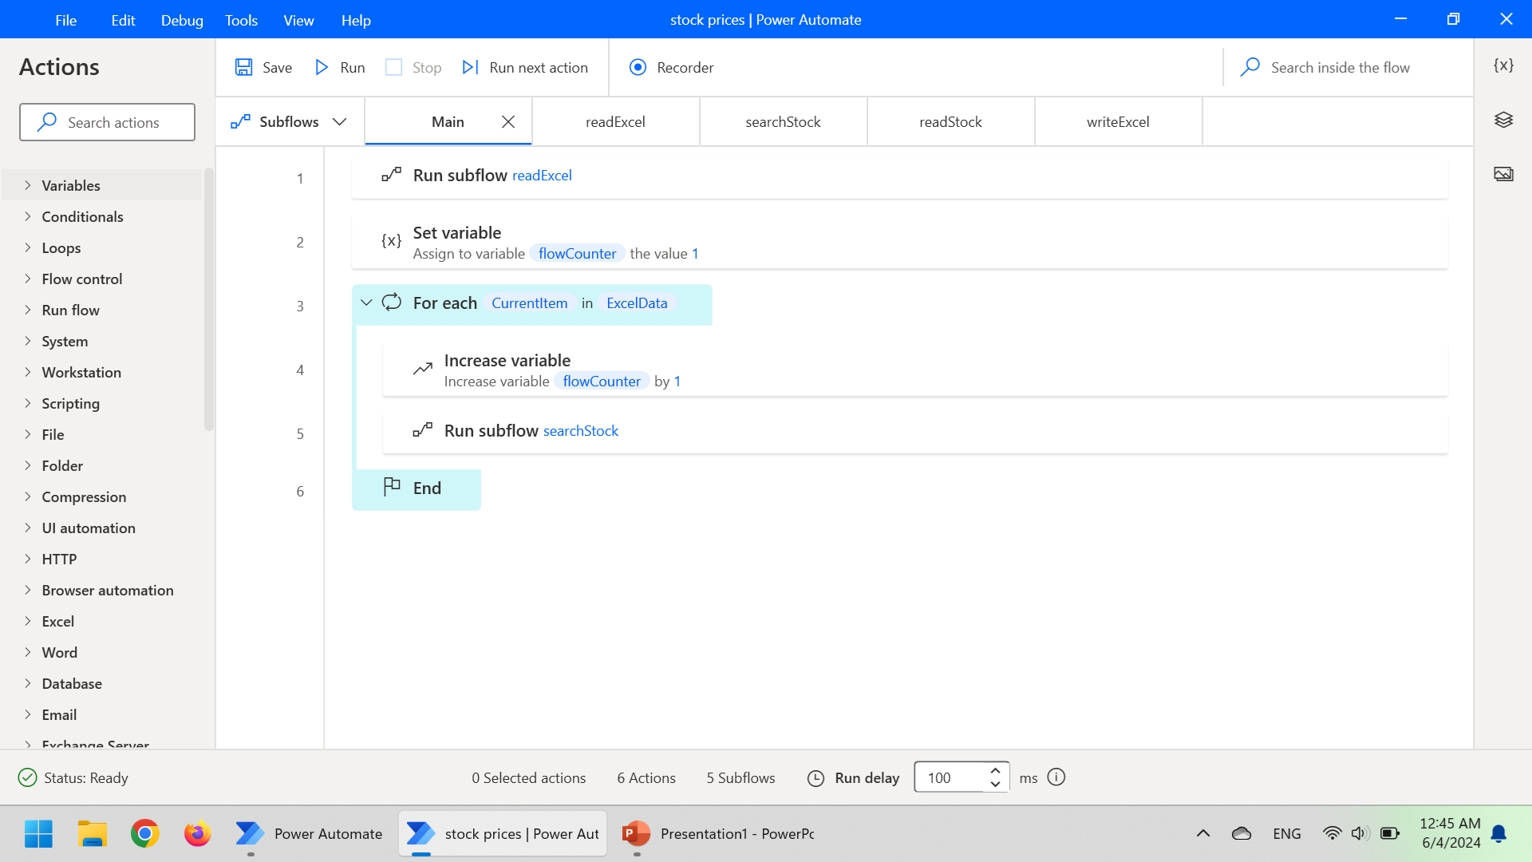
Main Workflow

Slide 4
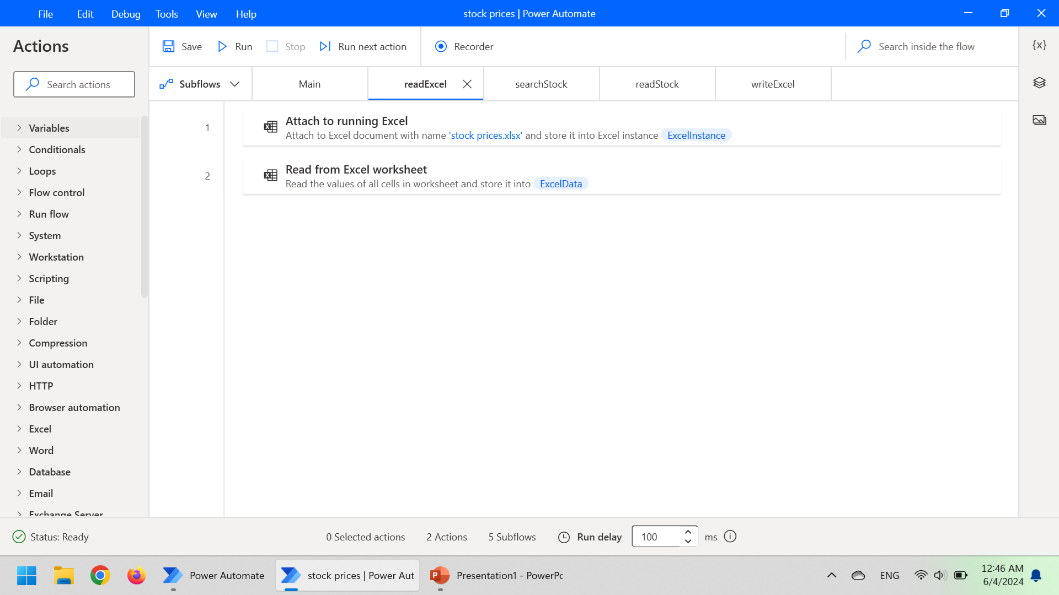
Subflow 1: readExcel

Slide 5
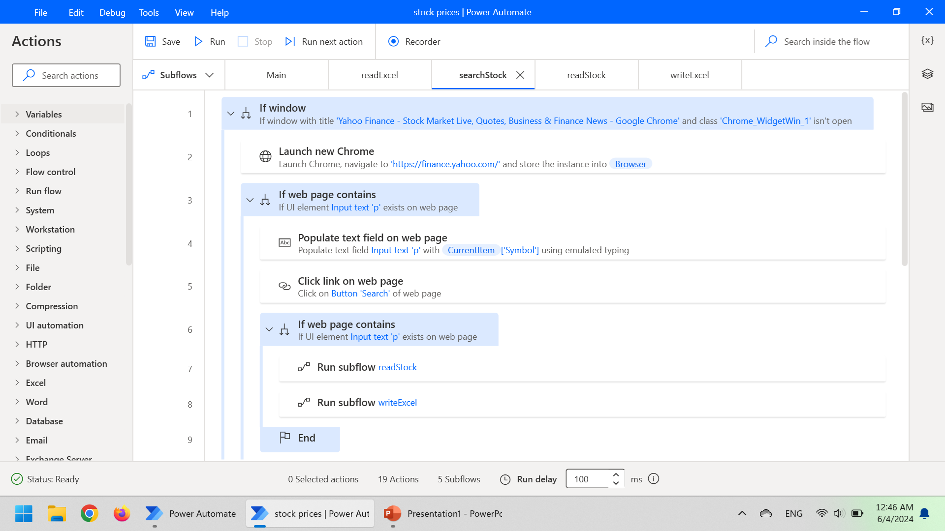
Subflow 2: searchStock

Slide 6
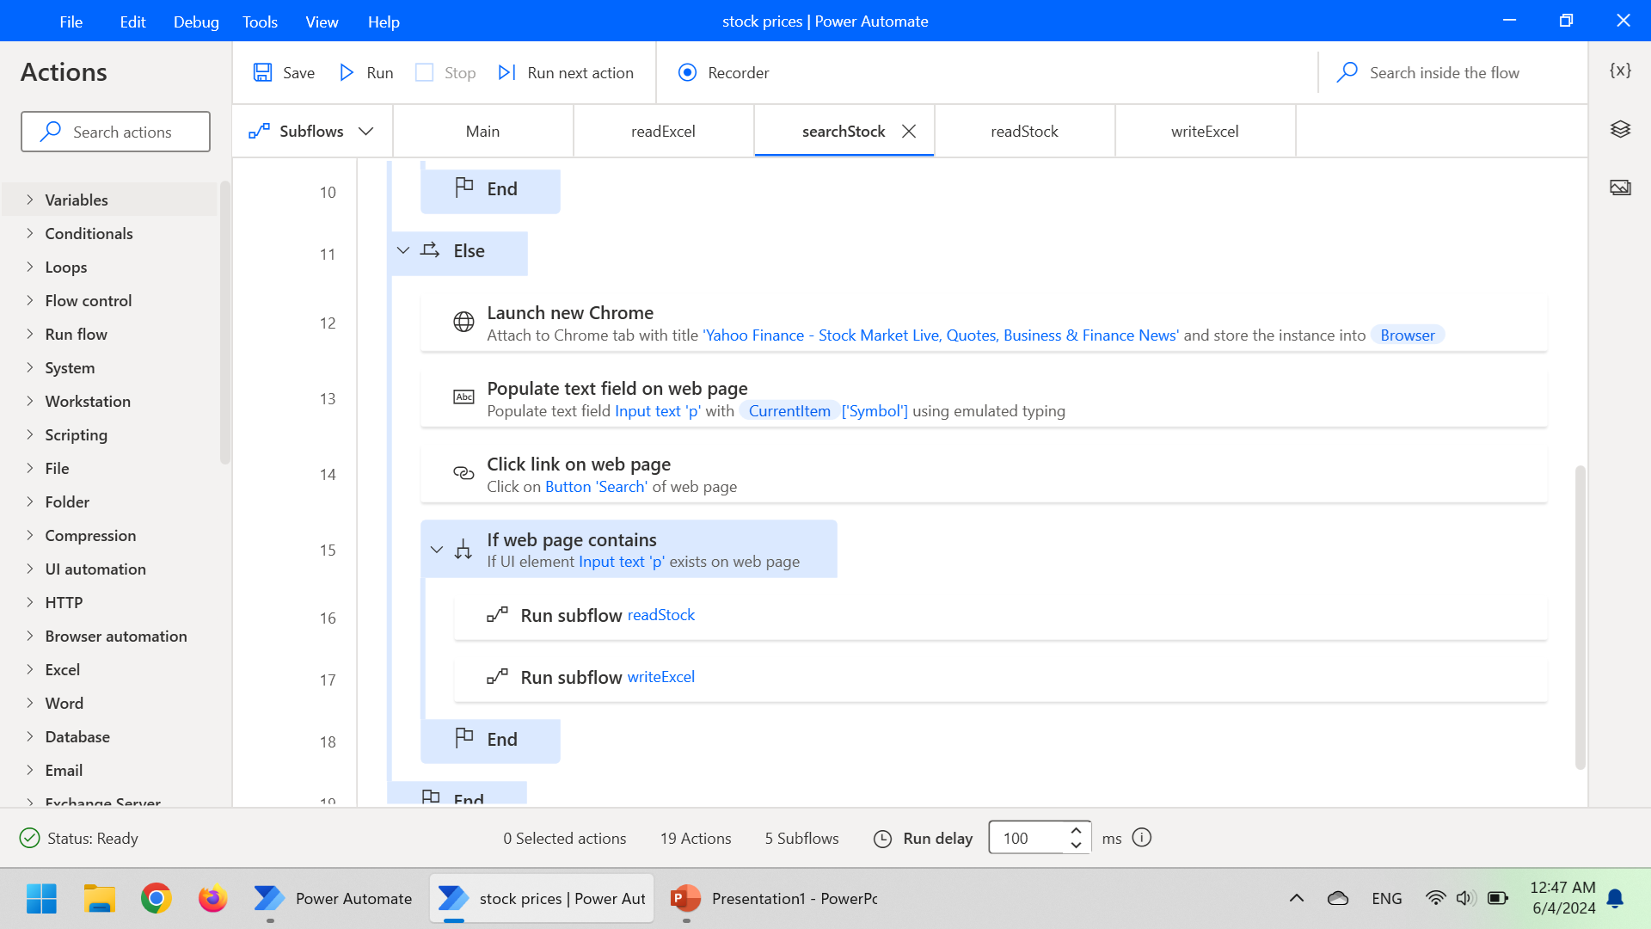
Subflow 2: searchStock (continued)

Slide 7
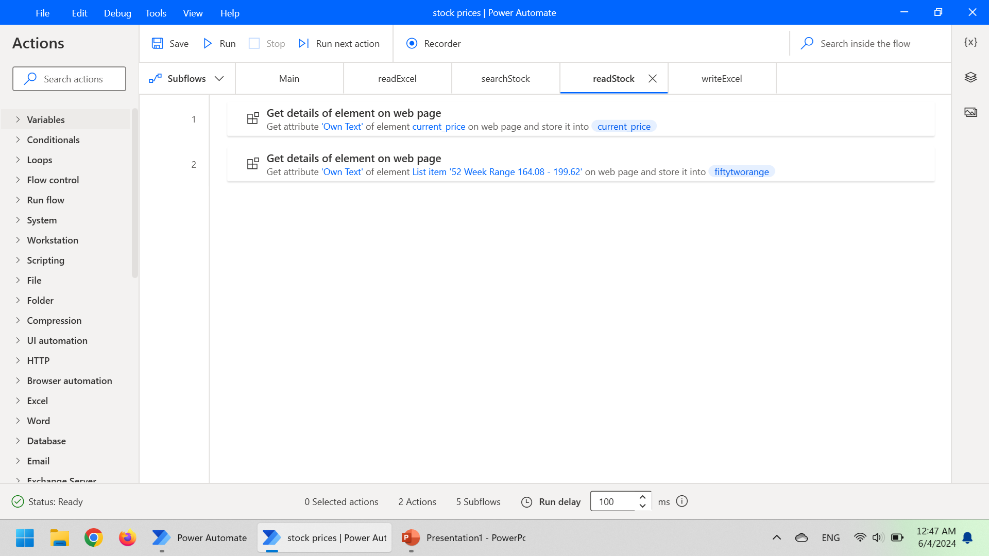
Subflow 3: readStock

Slide 8
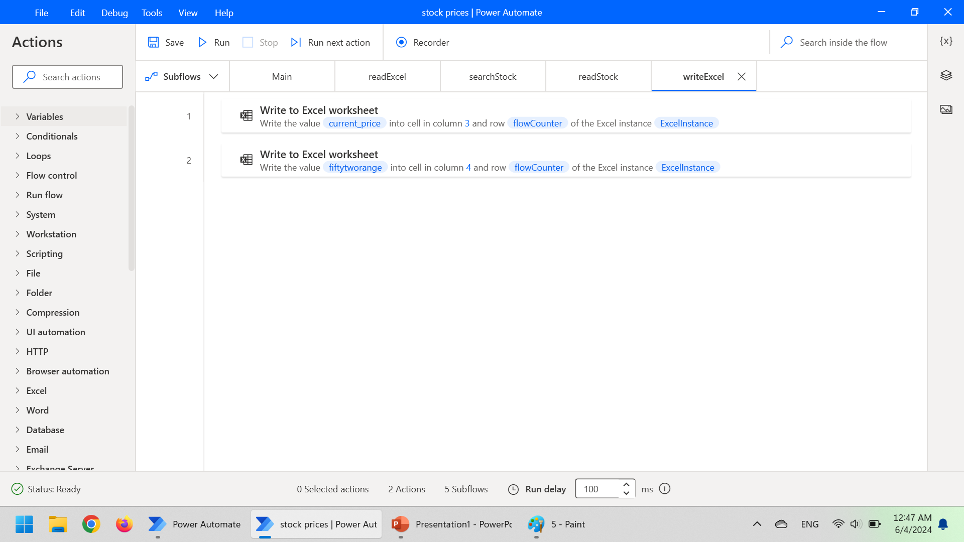
Subflow 4: writeExcel

Slide 9
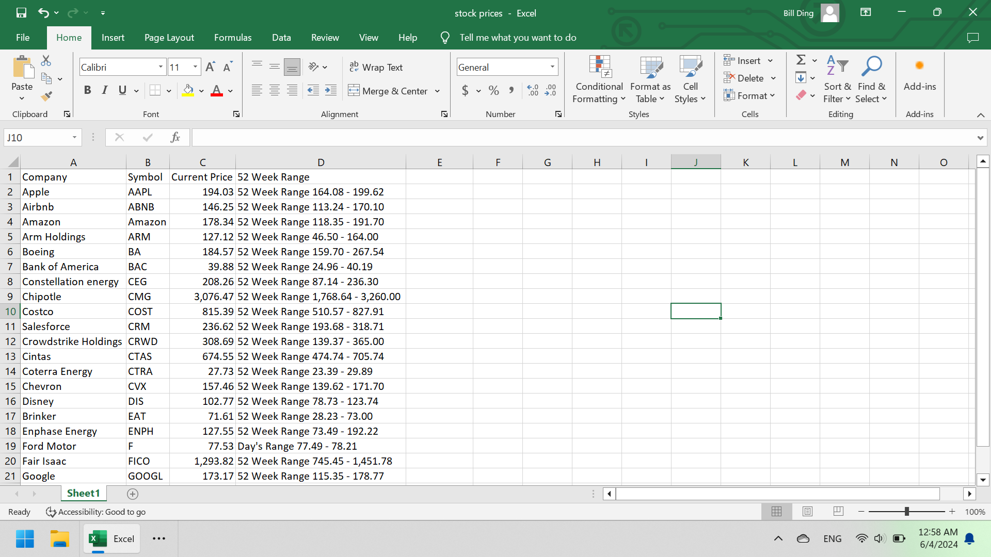
Result

